Slide 1
Introduction to Databases and Access
Part 1

Slide 2
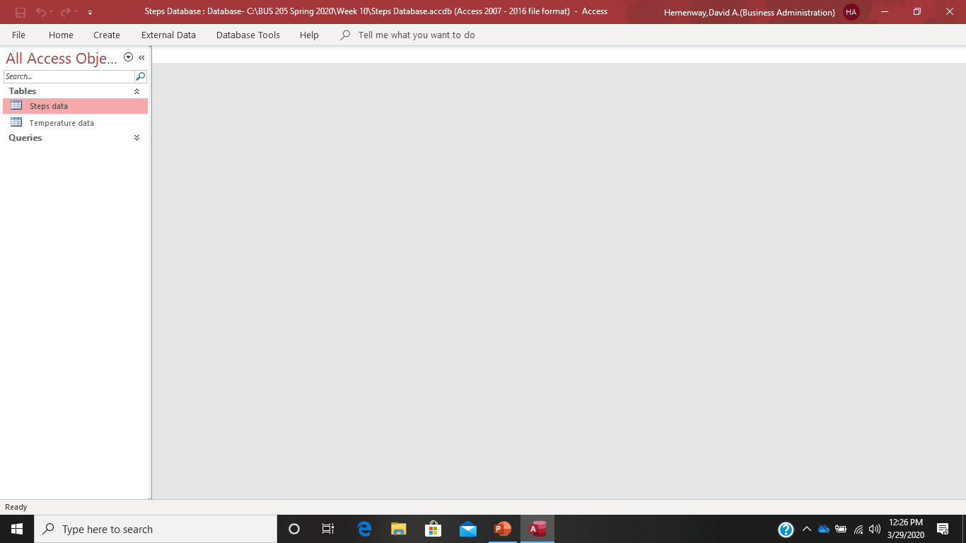
Pull up the Steps Access Database from BlackBoard:

Slide 3
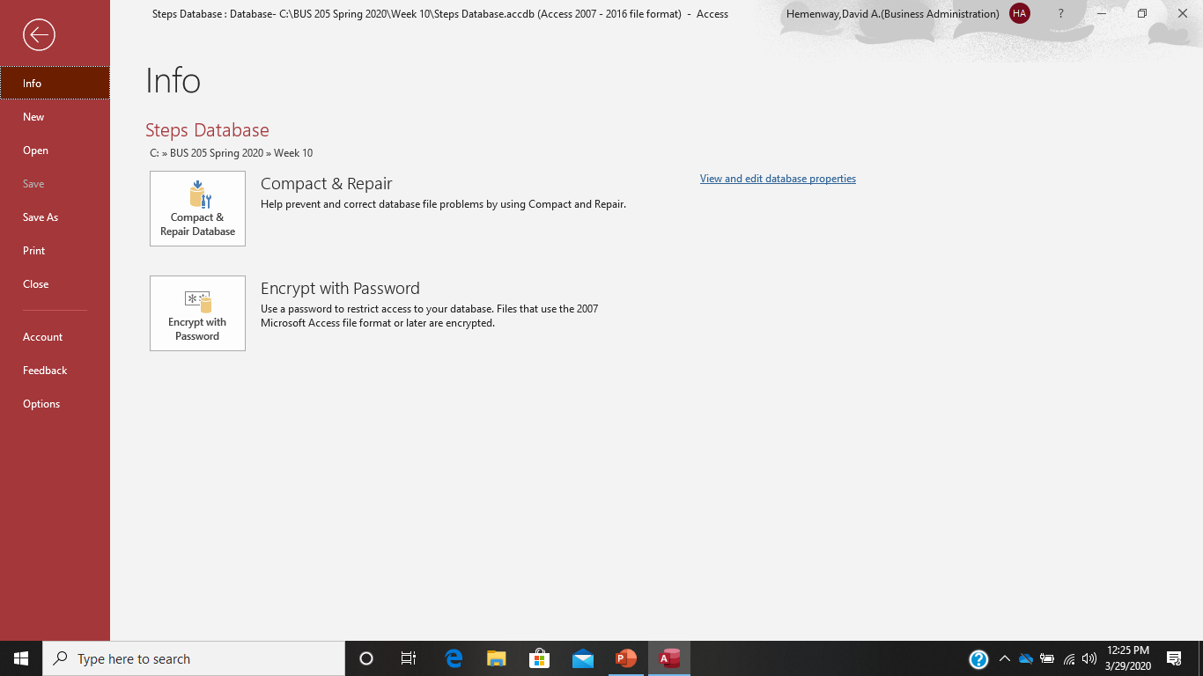
If you press the File button you get this:

Slide 4
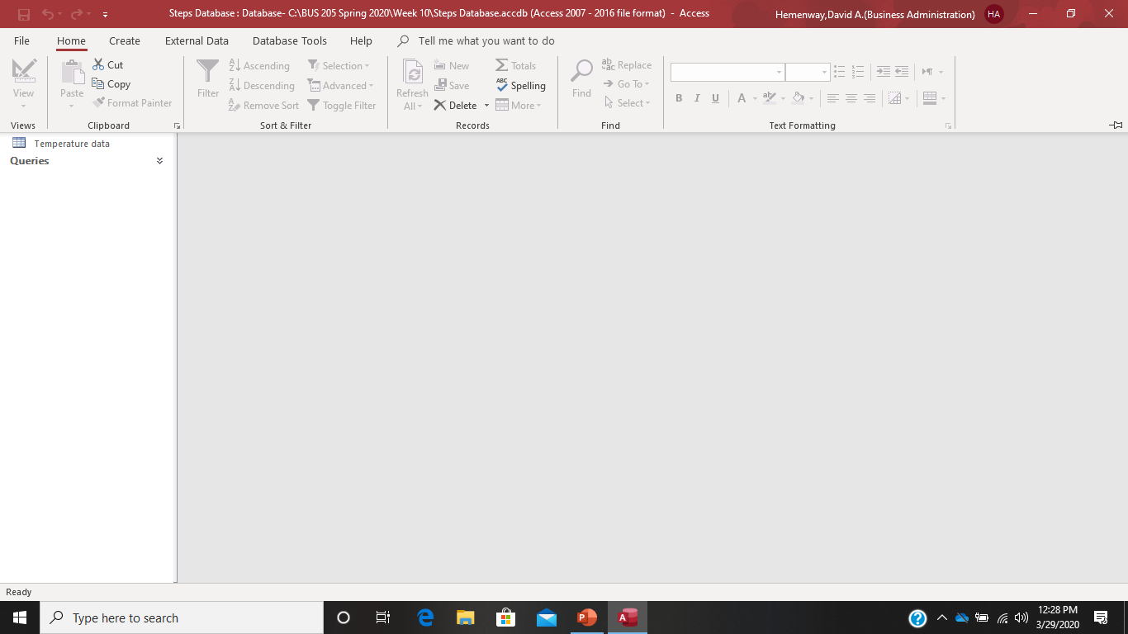
If You Press the Home Button:

Slide 5
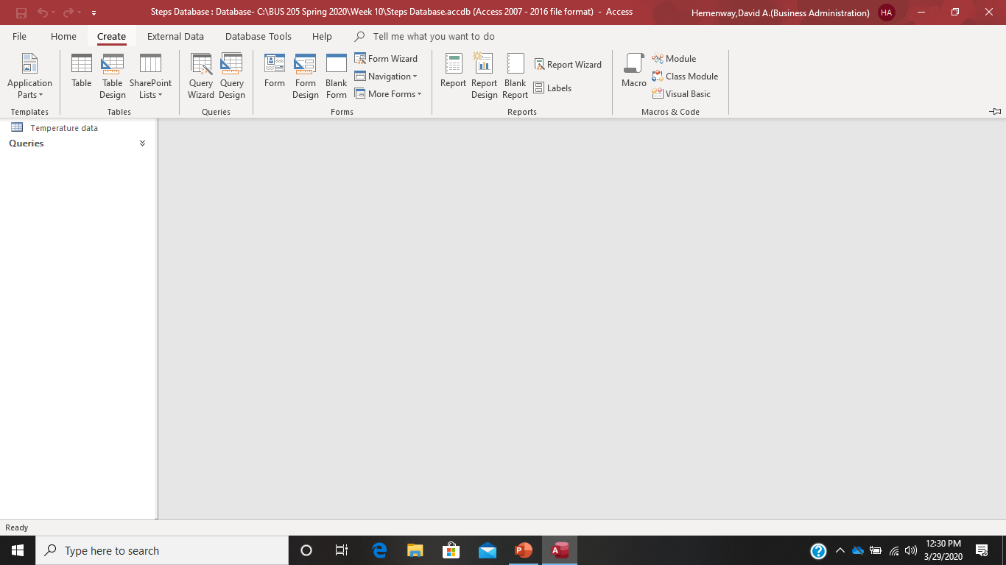
If You Press the Create Button:

Slide 6
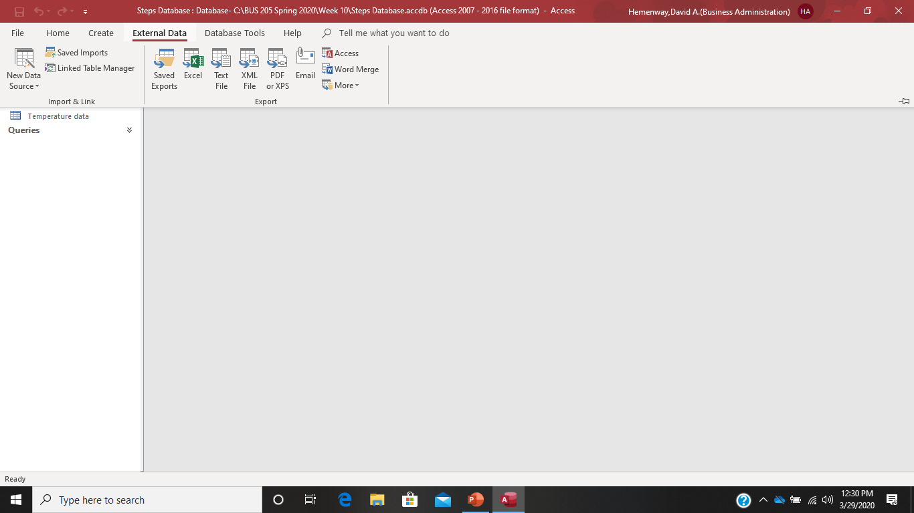
If You Press the External Data Button:

Slide 7
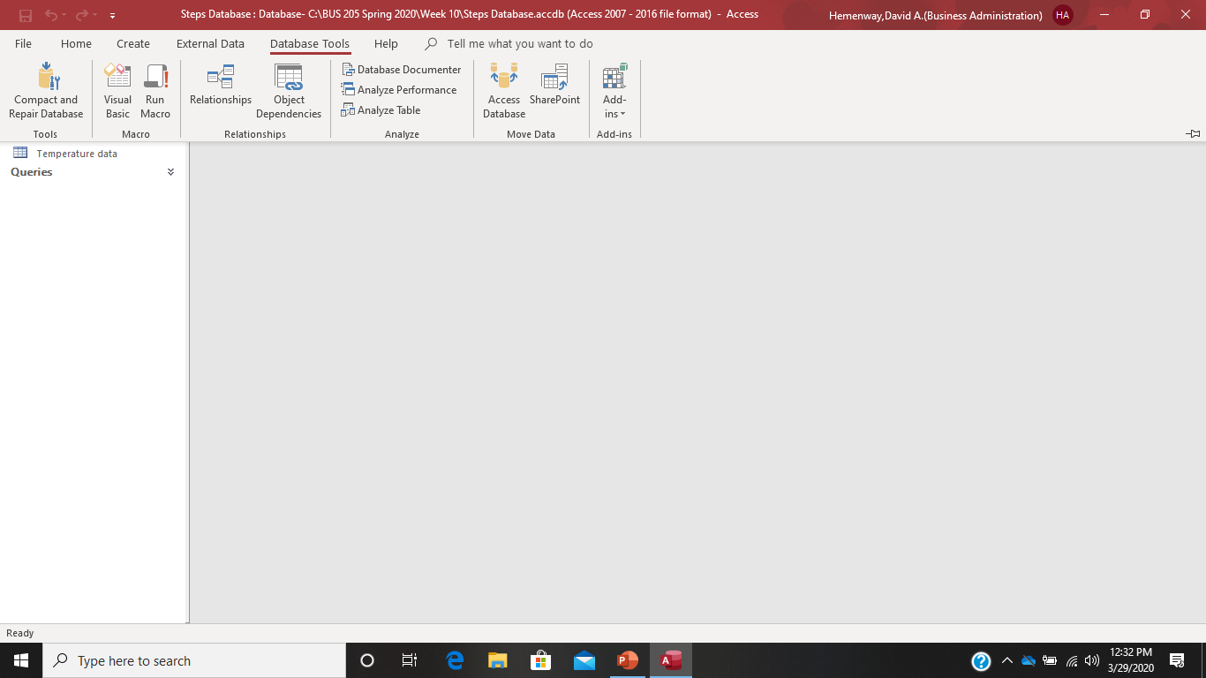
If You Press the Database Tools Button:

Slide 8
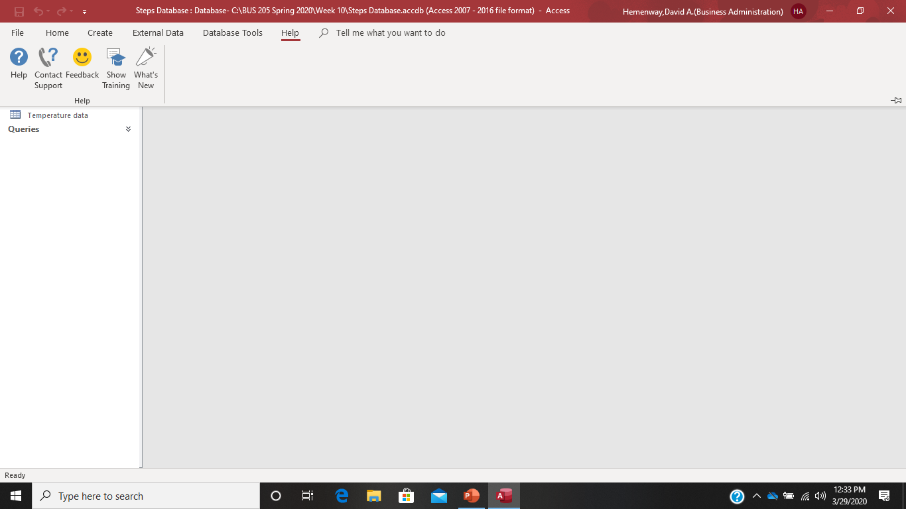
If You Press the Help Button:

Slide 9
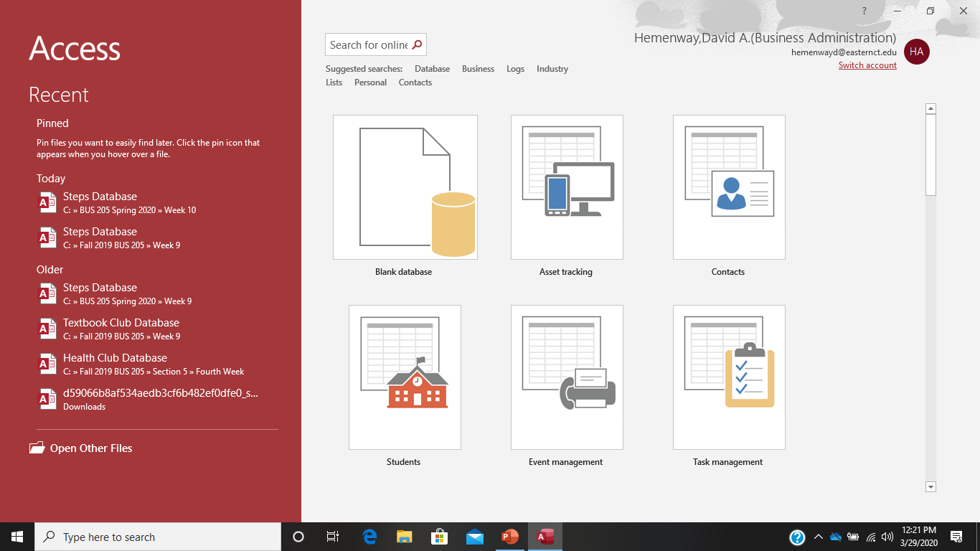
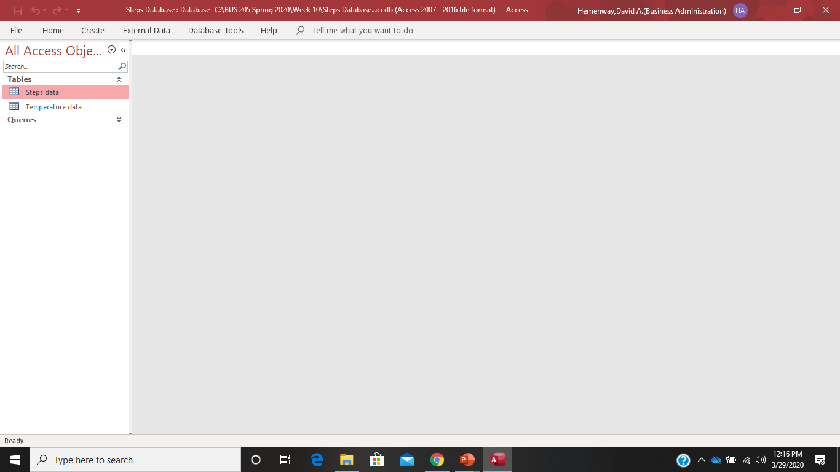
Pull Up The Steps Database from Blackboard

Slide 10
The Steps Access Database from BlackBoard:

Slide 11
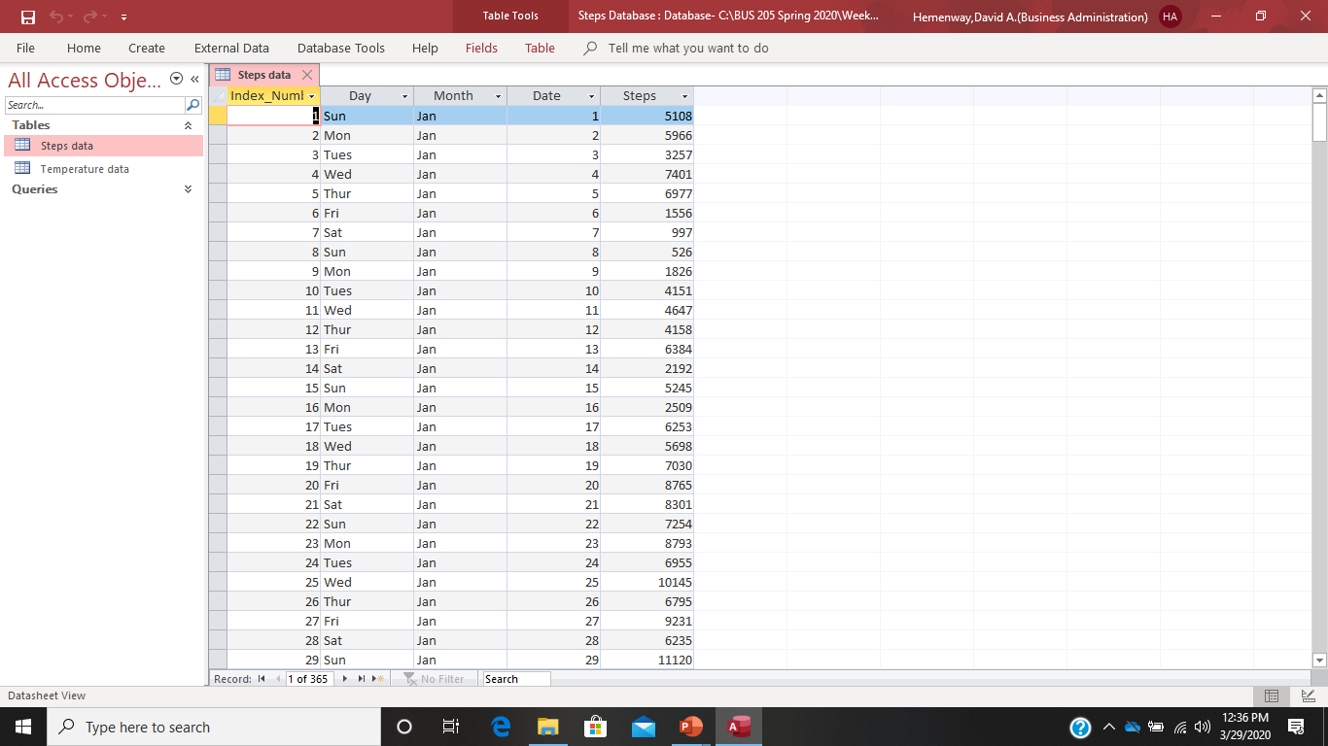
Press the Steps data Button:

Slide 12
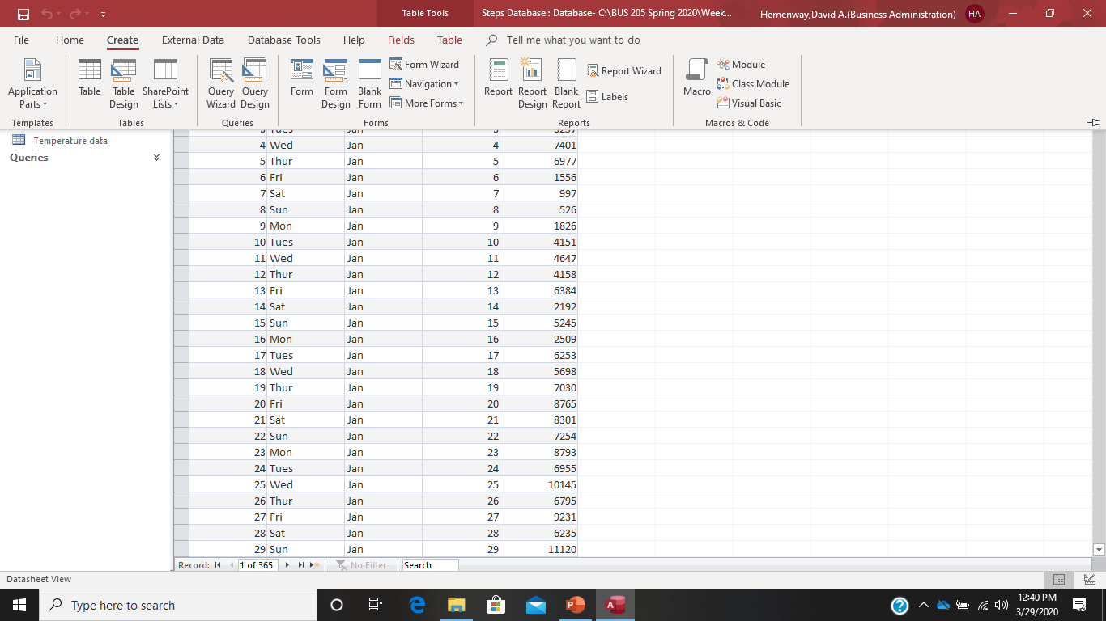
Creating a Simple Query: Press the Create Button

Slide 13

Press the Query Wizard Button Under the Create Menu:

Slide 14
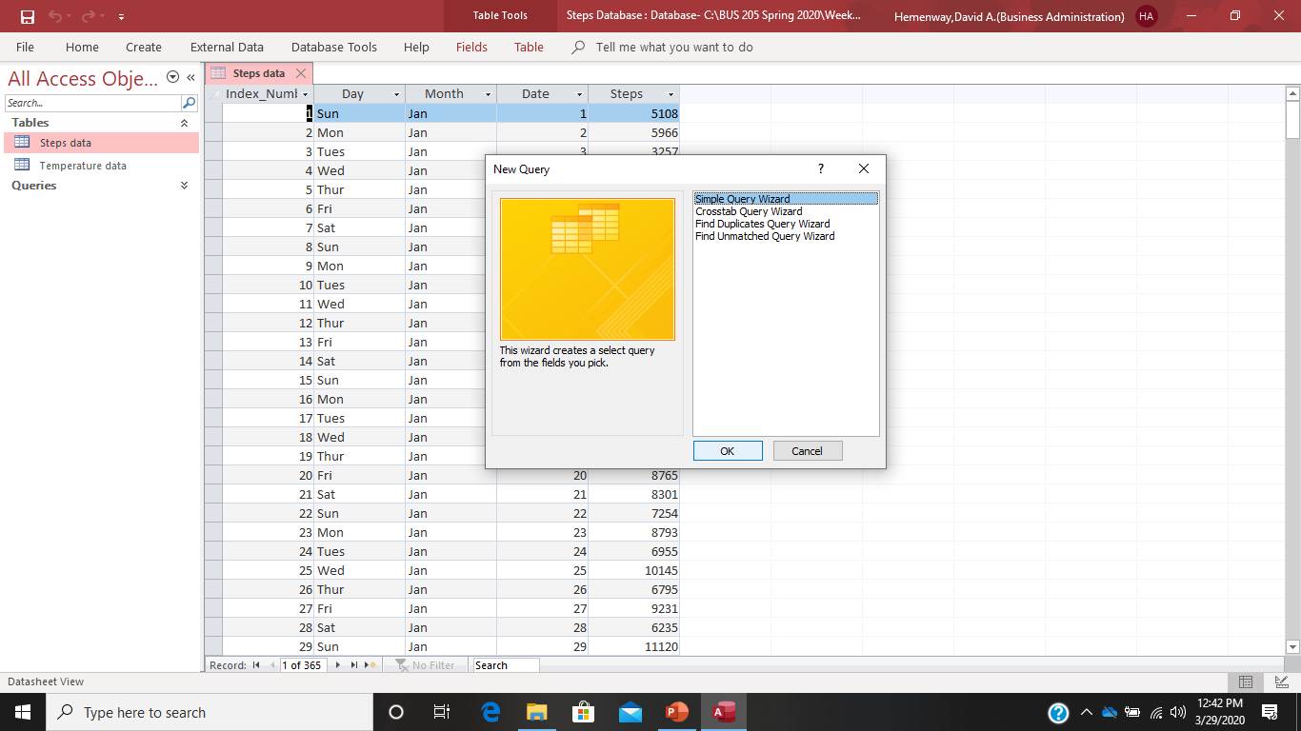
Choose the Create Simple Query Wizard Option:

Slide 15
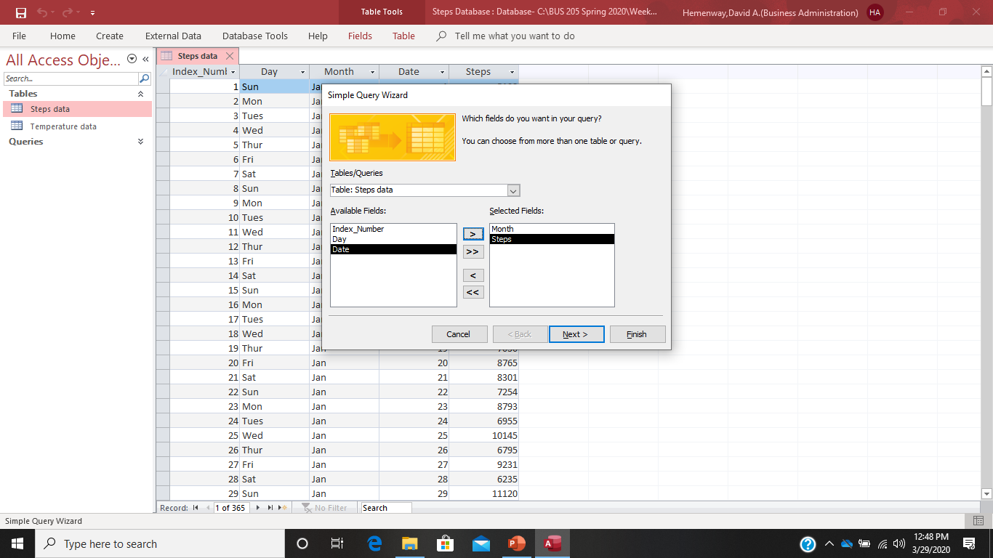
Select Month and Steps From the Available Fields:

Slide 16
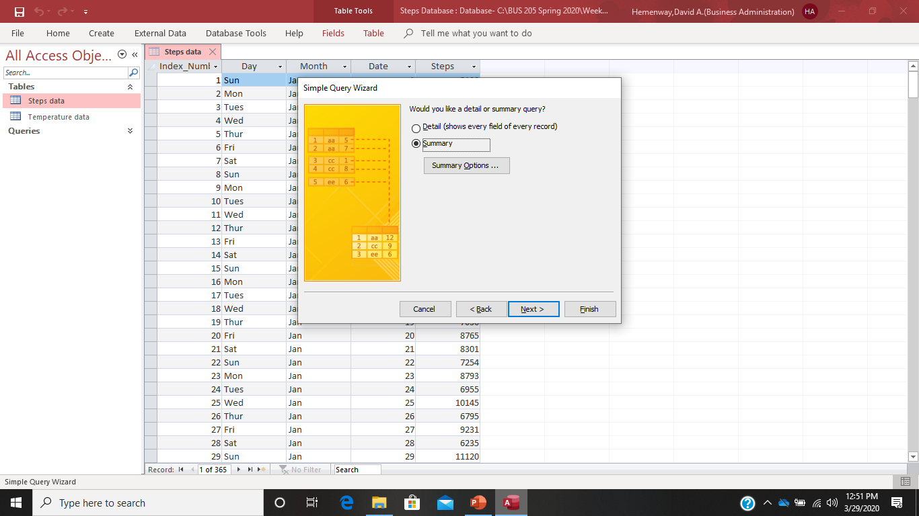
Select Summary and Summary Options Buttons:

Slide 17
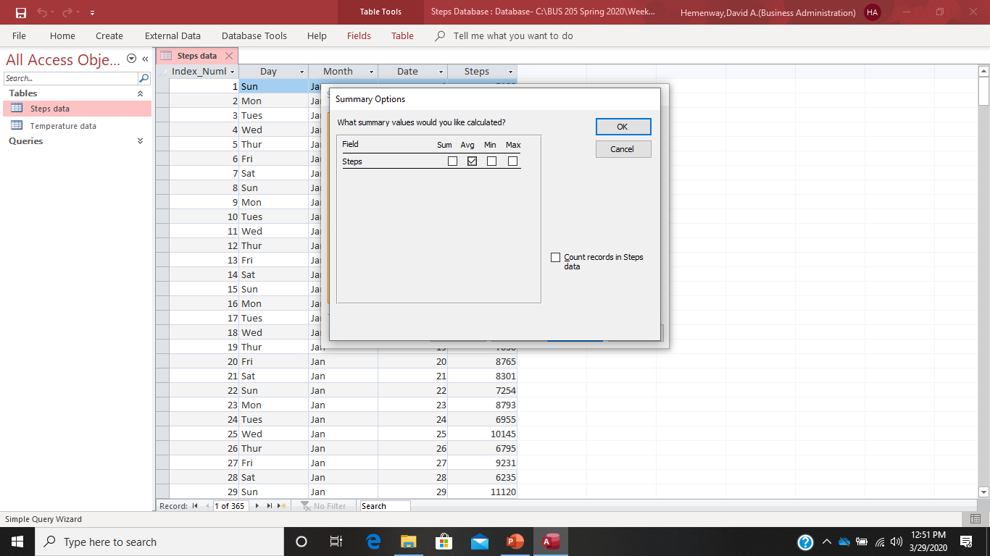
After selecting Summary Options Choose Steps Average:

Slide 18
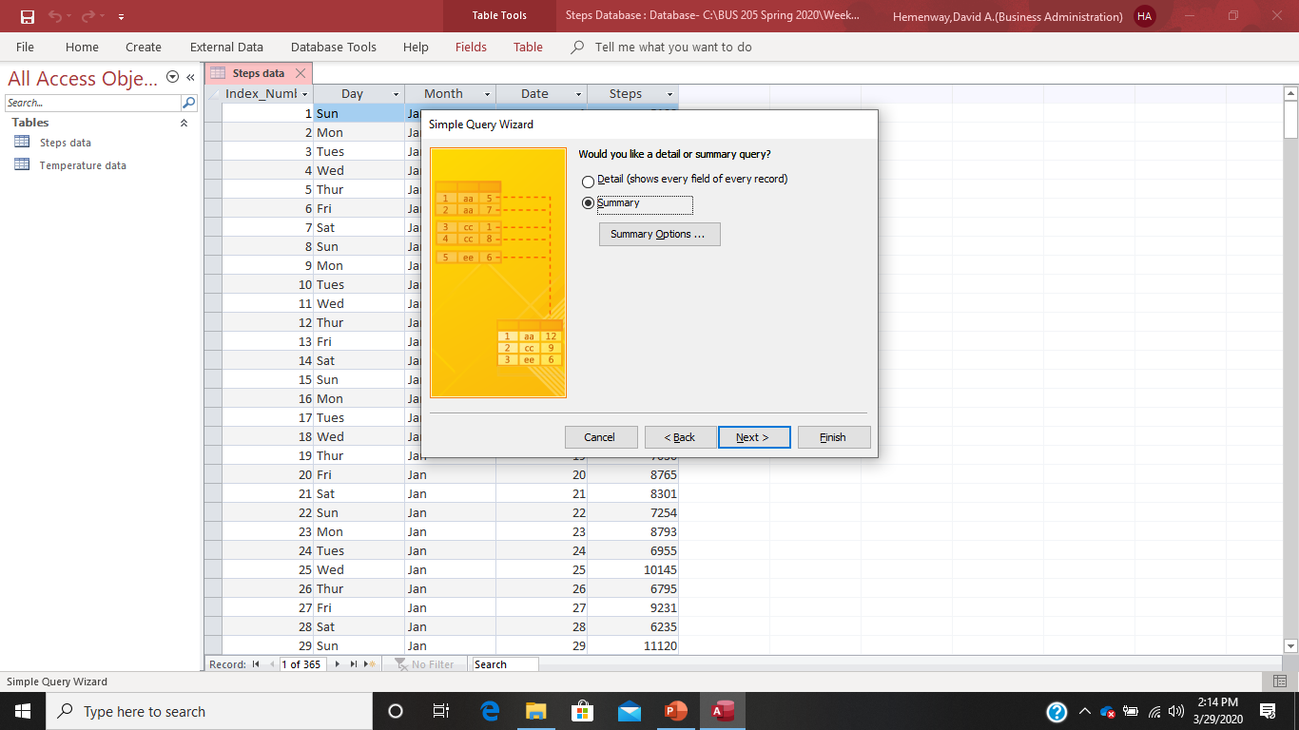
After you have selected your Summary Options, select Finish

Slide 19
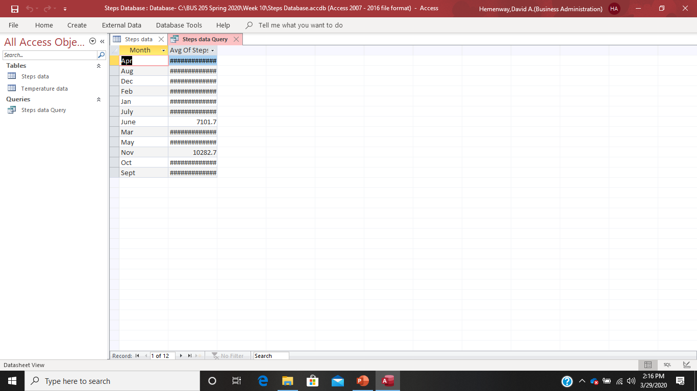
And, low and behold, you get a messy report:

Slide 20
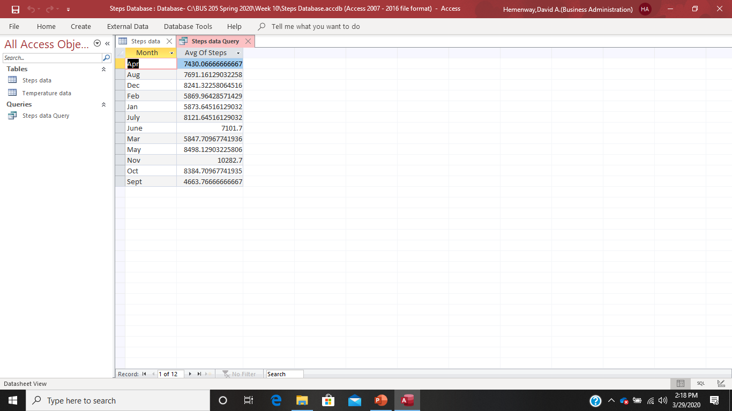
How do you remove all the ######? Simply widen that column by dragging it!

Slide 21
Monthly Summary Table From the Steps Project:
Table 2
Dave's Steps Database
Monthly Statistics
 | Average
October | 8,385
November | 10,283
December | 8,241
January | 5,874
February | 5,870
March | 5,848
April | 7,430
May | 8,498
June | 7,102
July | 8,122
August | 7,691
September | 4,664
Yearly Average | 7,346
Source: Dave's Steps Data

Slide 22
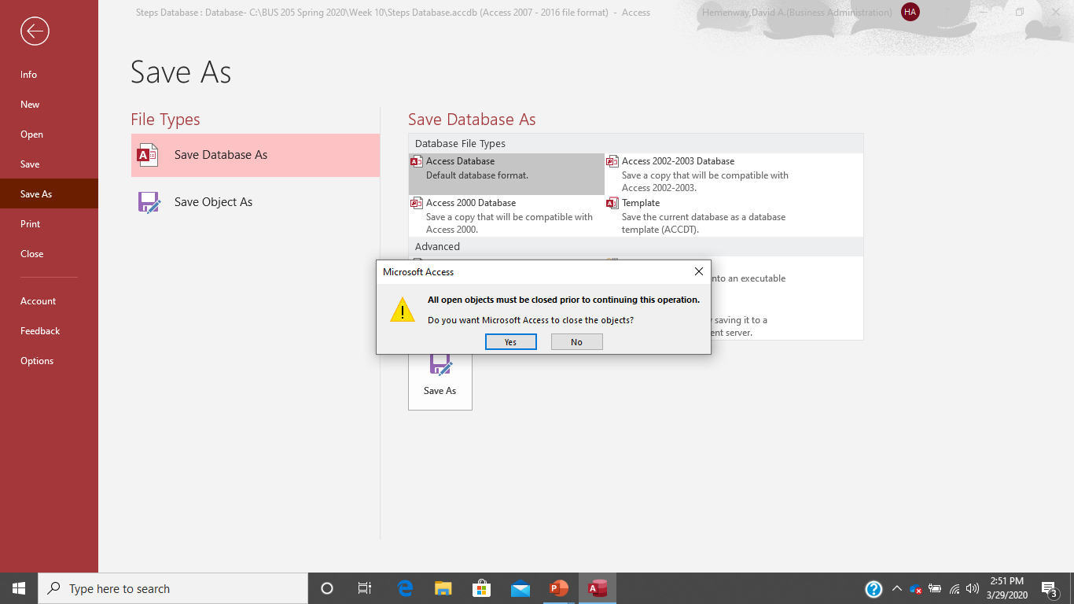
When Saving Your Access File, You May Get This Message: Say Yes and the File Will Save for You

Slide 23
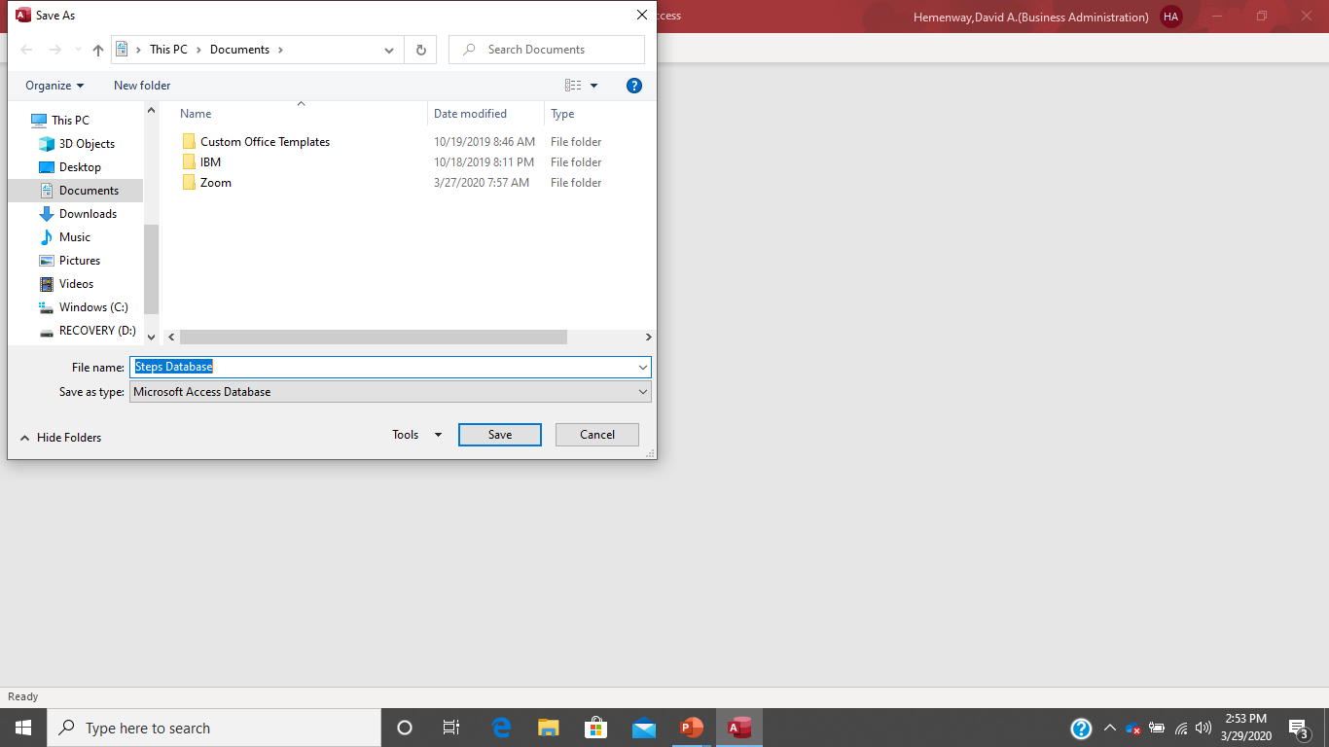
Access File Saving Default: Remember to put the file where you want it!

